Slide 1
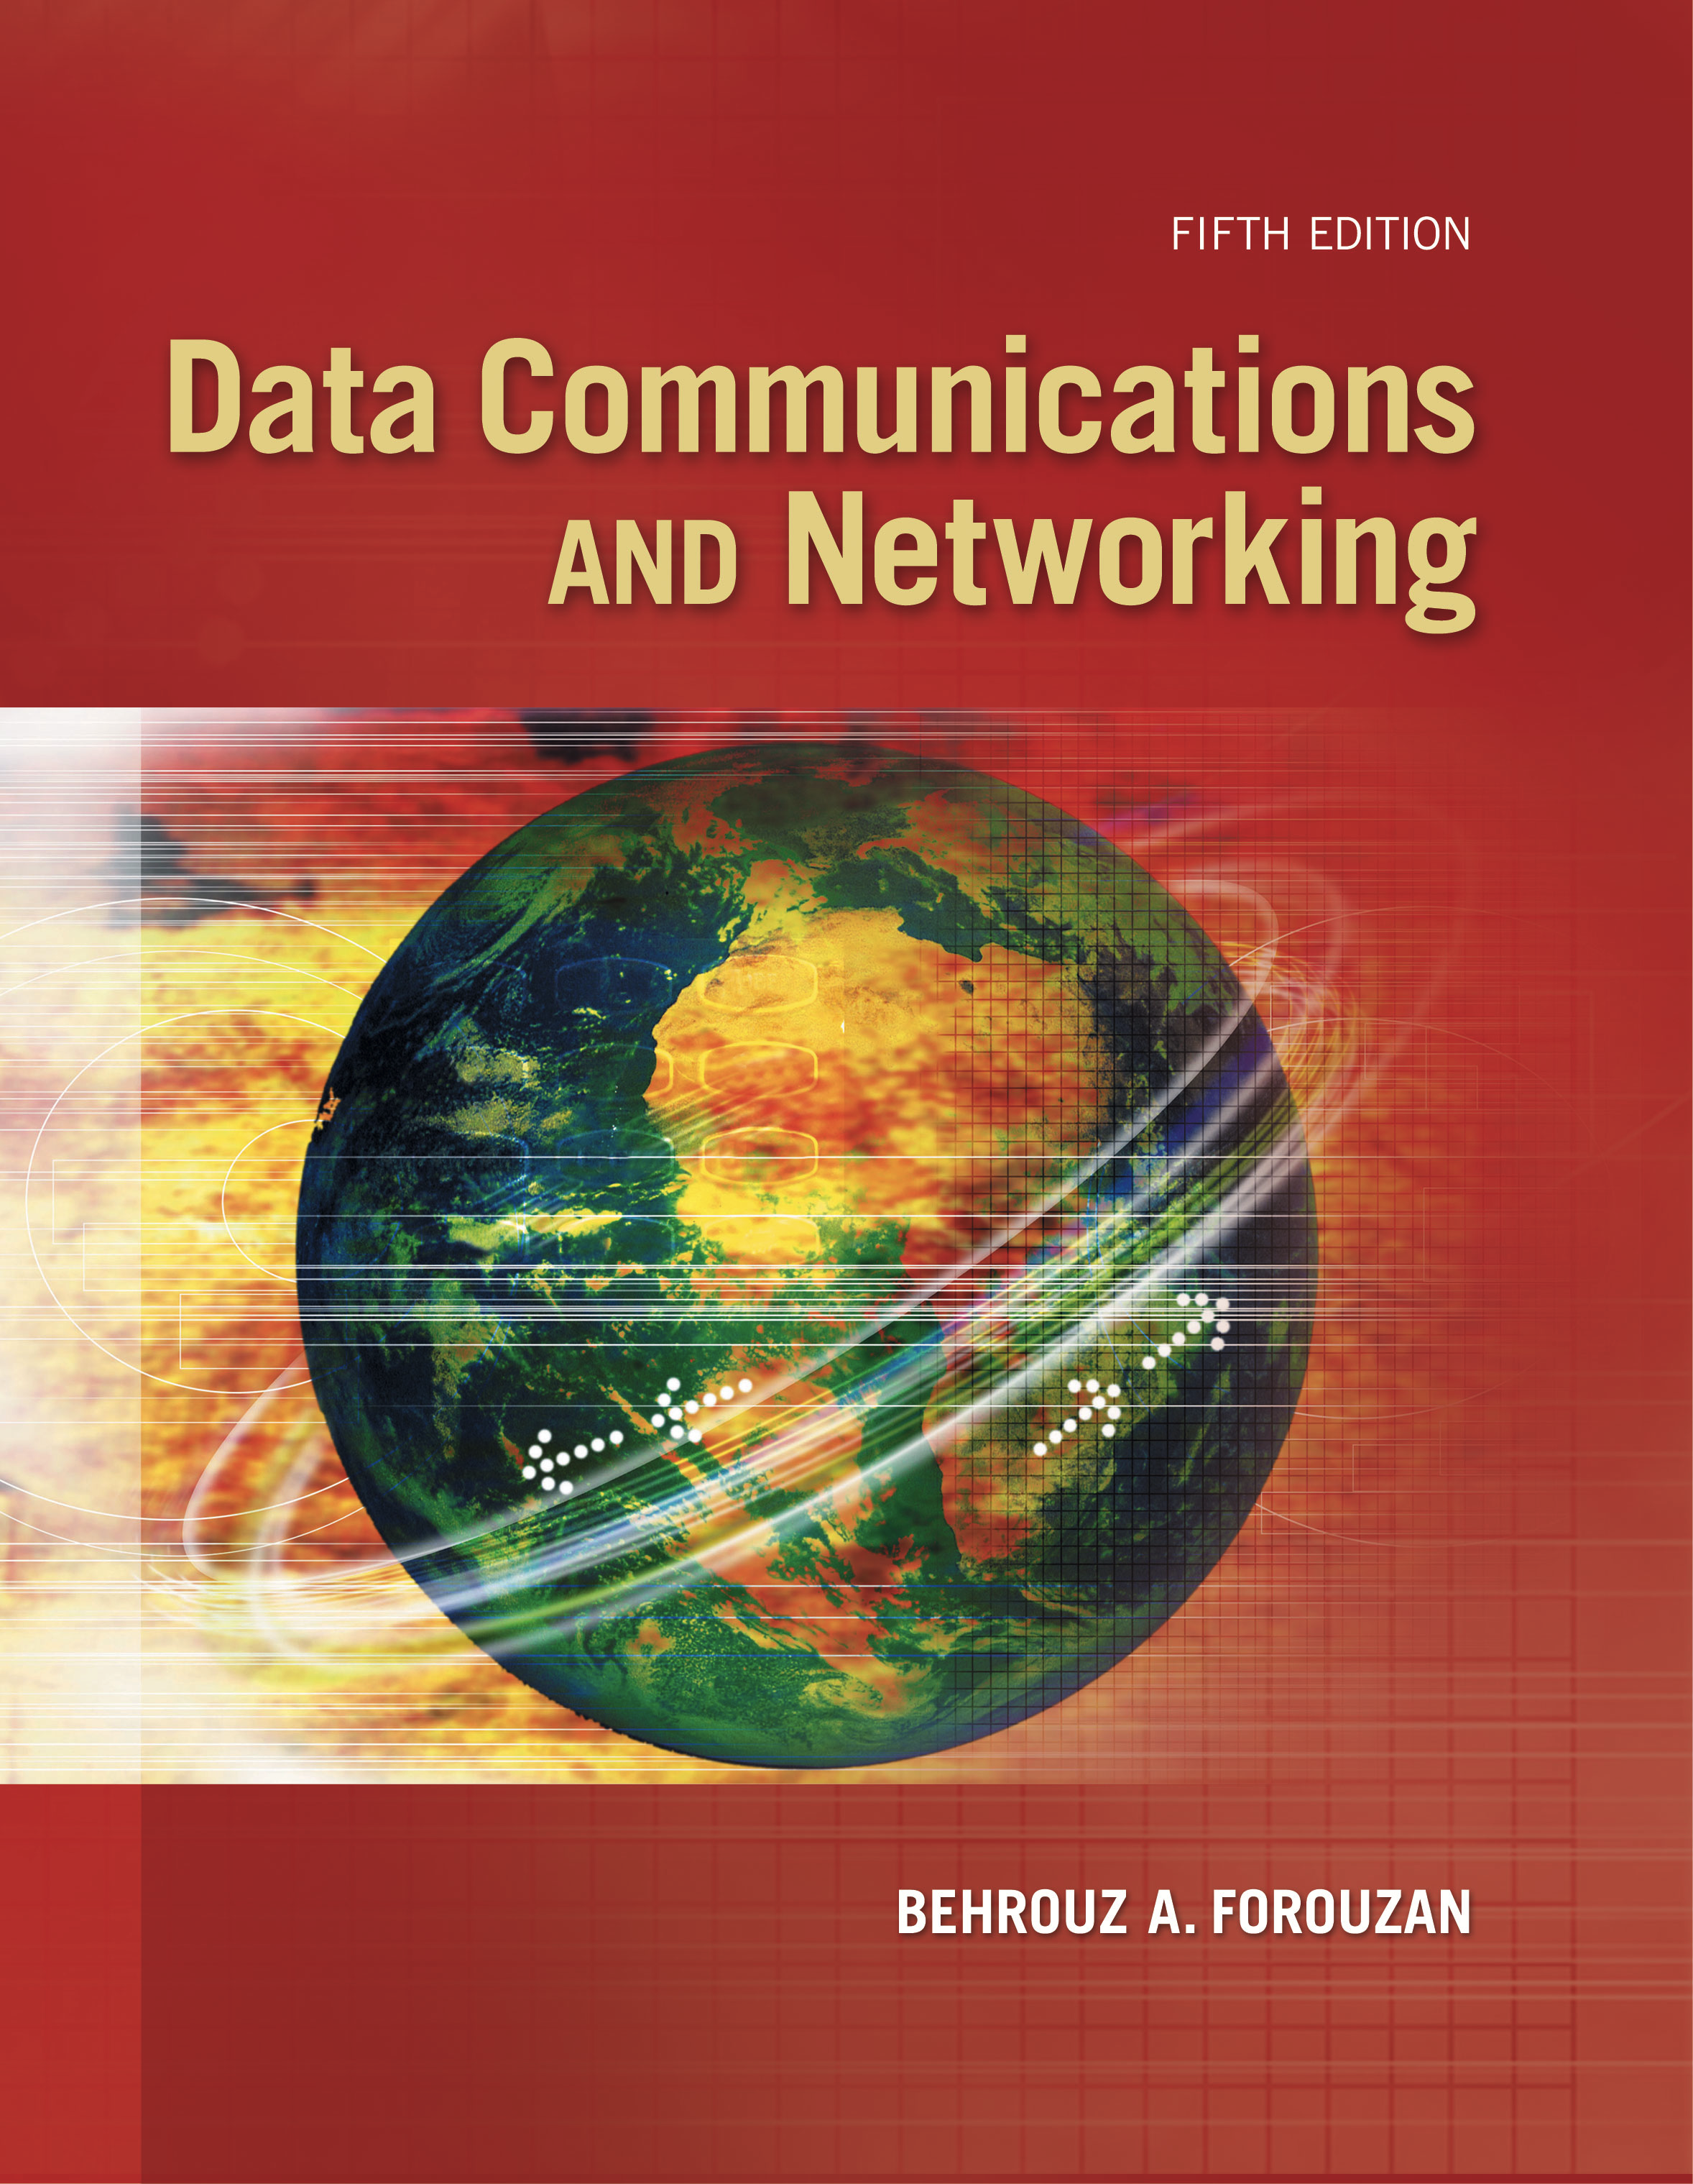
Computer Networks
IPV4
S.V.Jansi Rani
Associate Professor / CSE

Slide 2
AGENDA
IPV4 Addresses
Address space
Notation
Classful addressing
Classless addressing
Subnetting
Address Aggregation

Slide 3



Slide 4
IPv4 ADDRESSES
An IPv4 address is a 32-bit address that uniquely and universally defines the connection of a host or a router to the Internet.
The IP address is the address of the connection, not the host or the router, because if the device is moved to another network, the IP address may be changed.

Slide 5
Address Space
A protocol like IPv4 that defines addresses has an address space.
An address space is the total number of addresses used by the protocol.
If a protocol uses b bits to define an address, the address space is 2^{b} because each bit can have two different values (0 or 1).
IPv4 uses 32-bit addresses, which means that the address space is 232 or 4,294,967,296 (more than four billion).

Slide 6
Address Space
Notations
There are three common notations to show an IPv4 address: binary notation (base 2), dotted-decimal notation (base 256), and hexadecimal notation (base 16).
In binary notation, an IPv4 address is displayed as 32 bits. To make the address more readable, one or more spaces are usually inserted between each octet (8 bits). Each octet is often referred to as a byte.
To make the IPv4 address more compact and easier to read, it is usually written in decimal form with a decimal point (dot) separating the bytes. This format is referred to as dotted-decimal notation.
Hexadecimal notation. It is equivalent to four bits. This means that a 32-bit address has 8 hexadecimal digits. This notation is often used in network programming.

Slide 7
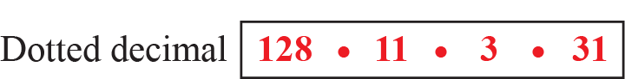

Notations

Slide 8
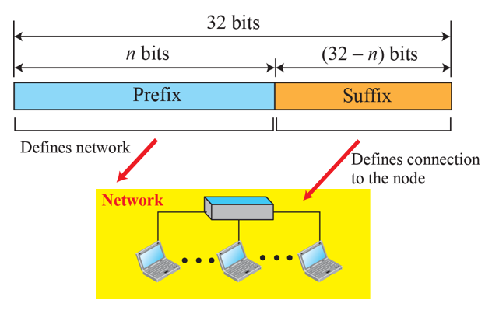
Address Space
Hierarchy in Addressing
A 32-bit IPv4 address is also hierarchical, but divided only into two parts
prefix, defines the network;
suffix, defines the node
prefix - fixed length or variable length.
fixed-length prefix - classful addressing.
variable-length network prefix -classless addressing

Slide 9
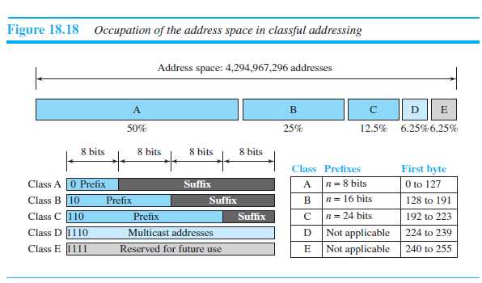
Classful Addressing
Class A- 128
Class B – 16384
Class C – 2,097,152

Slide 10
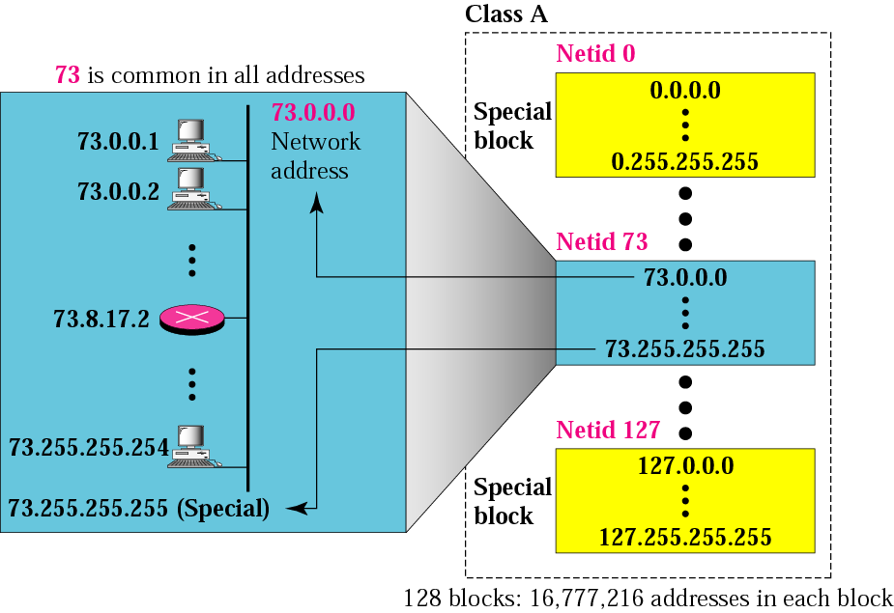

Slide 11
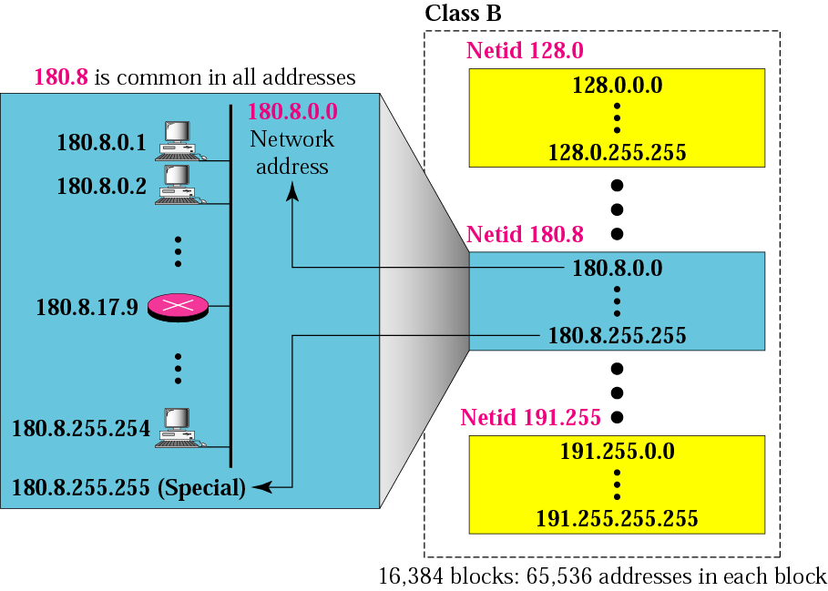

Slide 12


Slide 13
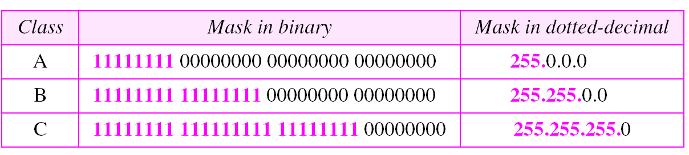
Default Mask
To find beginning address / network address, we use default mask
Address OR Mask -> Network Address

Slide 14
Address Depletion
Addresses were not distributed properly - no more addresses available for organizations
Eg: Class A - assigned to only 128 organizations in
the world
Each organization needs to have a single network (seen by the rest of the world) with 16,777,216 nodes (computers in this single network) – mostly wasted (unused
Solution
Subnetting – Dividing large block into smaller one
Supernetting –Combining smaller block to larger one
Advantage of Classful Addressing
Easy to identify the class based on the prefix

Slide 15
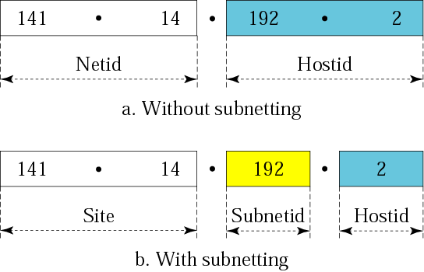
Subnetting
Subnetting is the practice of dividing a network into two or more smaller networks. It increases routing efficiency, enhances the security of the network and reduces the size of the broadcast domain.

Slide 16
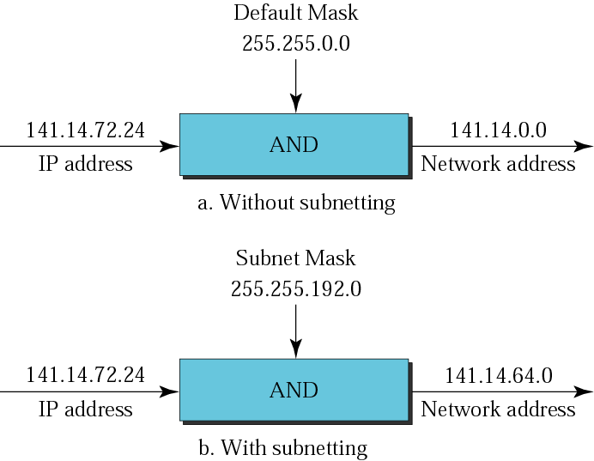

Slide 17
Example
What is the subnetwork address if the destination address is 130.45.34.56 and the subnet mask is 255.255.240.0?
Solution We apply the AND operation on the address and the subnet mask.
Address ➡ 10000010 00101101 00100010 00111000
Subnet Mask ➡ 11111111 11111111 11110000 00000000
Subnetwork Address ➡ 11001000 00101101 00100000 00000000.
130.45.32.0

Slide 18
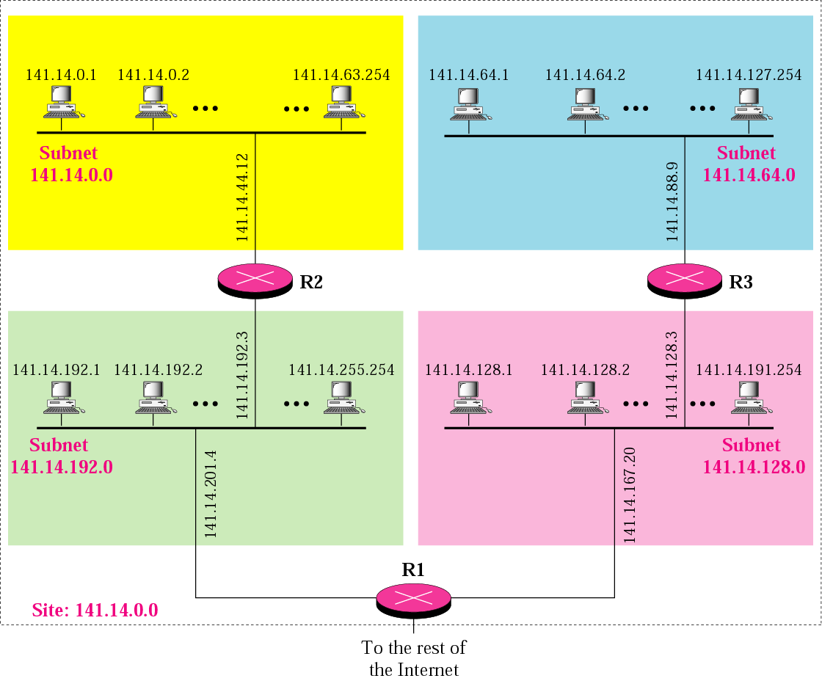
A network with three levels of hierarchy (subnetted)

Slide 19
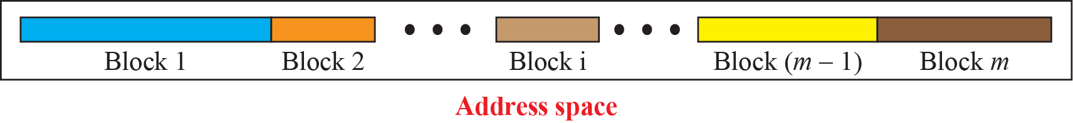
Classless Addressing
In classless addressing, the whole address space is divided into variable length blocks.
The prefix in an address defines the block (network); the suffix defines the node (device).
Block of 2⁰, 2¹, 2², . . . , 2³² addresses. Restrictions is that the number of addresses in a block needs to be a power of 2.

Slide 20
Classless Addressing
Unlike classful addressing, the prefix length in classless addressing is variable.
The size of the network is inversely proportional to the length of the prefix.
A small prefix means a larger network; a large prefix means a smaller network.

Slide 21
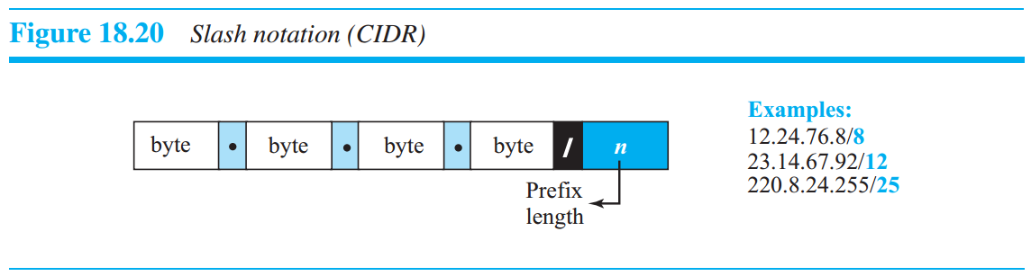
Classless Addressing
Prefix length: Slash Notation
The first question that we need to answer in classless addressing is how to find the prefix length if an address is given.
Since the prefix length is not inherent in the address, we need to separately give the length of the prefix. In this case, the prefix length, n, is added to the address, separated by a slash. The notation is informally referred to as slash notation and formally as classless interdomain routing or CIDR (pronounced cider) strategy.

Slide 22
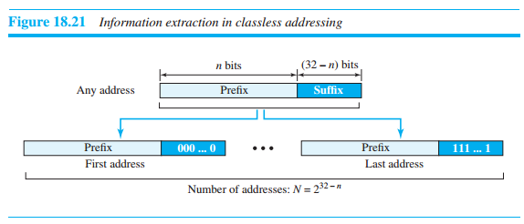
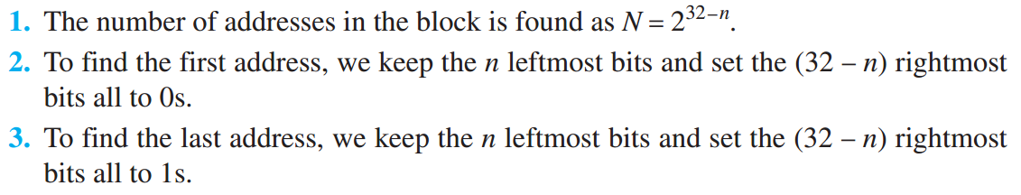
Classless Addressing
Extracting information from an address
Given any address in the block, we normally like to know three pieces of information about the block to which the address belongs: the number of addresses, the first address in the block, and the last address. Since the value of prefix length, n, is given, we can easily find these three pieces of information.

Slide 23
Example
A classless address is given as 167.199.170.82/27. We can find the above three pieces of information as follows. The number of addresses in the network is 2^{32− n} = 2⁵ = 32 addresses. The first address can be found by keeping the first 27 bits and changing the rest of the bits to 0s.
The last address can be found by keeping the first 27 bits and changing the rest of the bits to 1s.

Slide 24
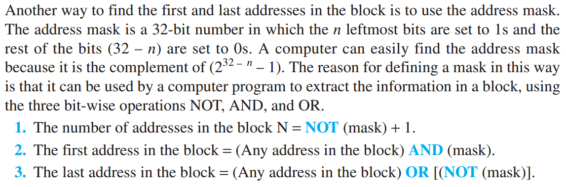
Classless Addressing
Address Mask

Slide 25
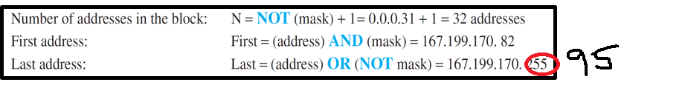
Example
We repeat Example using the mask. The mask in dotted-decimal notation is 256.256.256.224 The AND, OR, and NOT operations can be applied to individual bytes using calculators and applets at the book website.

Slide 26
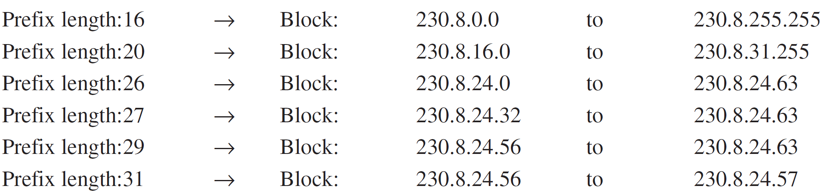
Example
In classless addressing, an address cannot per se define the block the address belongs to. For example, the address 230.8.24.56 can belong to many blocks. Some of them are shown below with the value of the prefix associated with that block.

Slide 27
Classless Addressing
Network address
The first address, the network address, is particularly important because it is used in routing a packet to its destination network.
When a packet arrives at the router from any source host, the router needs to know to which network the packet should be sent: from which interface the packet should be sent out. When the packet arrives at the network, it reaches its destination host using another strategy that we discuss later.

Slide 28
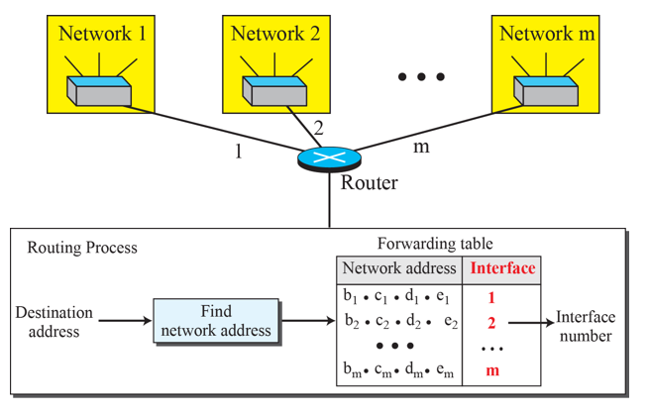
Classless Addressing
Network address
After the network address has been found, the router consults its forwarding table to find the corresponding interface from which the packet should be sent out. The network address is actually the identifier of the network; each network is identified by its network address.

Slide 29
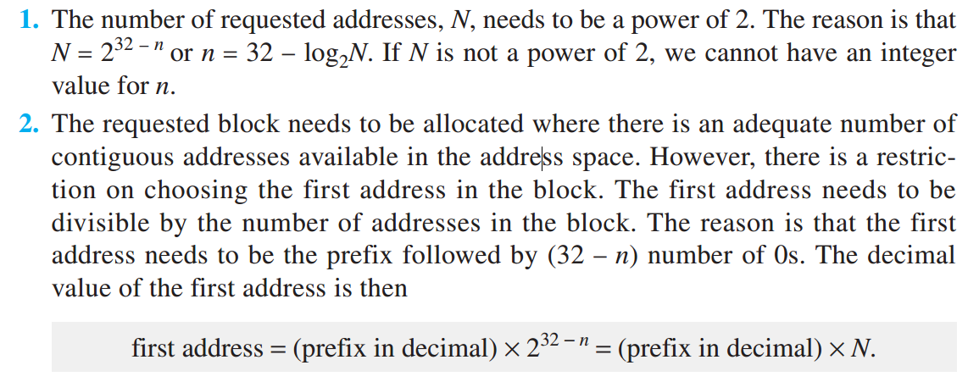
Classless Addressing
Block allocation
Responsibility of block allocation is given to a global authority called the Internet Corporation for Assigned Names and Numbers (ICANN).

Slide 30
Example
An ISP has requested a block of 1000 addresses. Since 1000 is not a power of 2, 1024 addresses are granted. The prefix length is calculated as n = 32 − log₂1024 = 22. An available block, 18.14.12.0/22, is granted to the ISP. It can be seen that the first address in decimal is
302,910,464
(0001 0010 0000 1110 0000 1100 0000 0000) ,
which is divisible by 1024.

Slide 31
Classless Addressing
Subnetting
More levels of hierarchy can be created using subnetting.
An organization (or an ISP) that is granted a range of addresses may divide the range into several subranges and assign each subrange to a subnetwork (or subnet).
Note that nothing stops the organization from creating more levels.
A subnetwork can be divided into several sub-subnetworks.
A sub-subnetwork can be divided into several sub-sub-subnetworks, and so on.

Slide 32
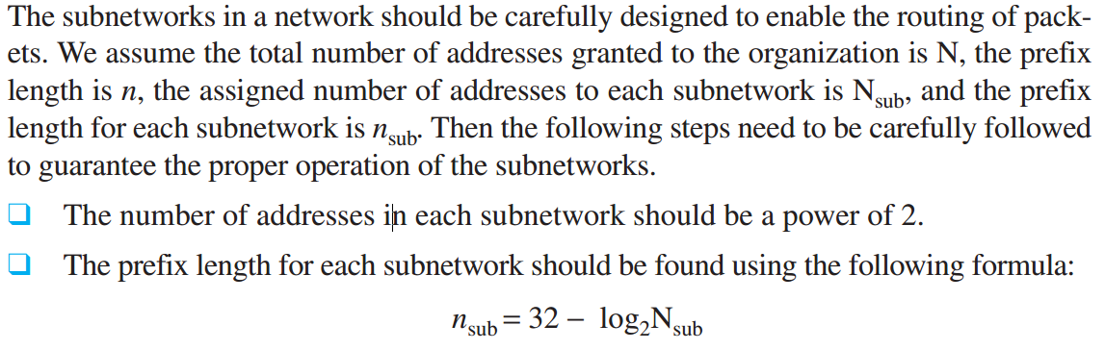
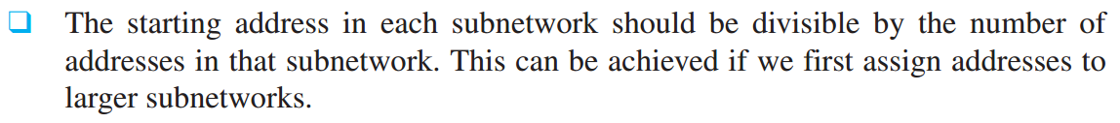
Classless Addressing
Designing subnets

Slide 33
Example
An organization is granted a block of addresses with the beginning address 14.24.74.0/24. The organization needs to have 3 subblocks of addresses to use in its three subnets: one subblock of 10 addresses, one subblock of 60 addresses, and one subblock of 120 addresses. Design the subblocks.
Solution
There are 2^{32– 24} = 256 addresses in this block. The first address is 14.24.74.0/24; the last address is 14.24.74.255/24. To satisfy the third requirement, we assign addresses to subblocks, starting with the largest and ending with the smallest one.

Slide 34
Example
a. The number of addresses in the largest subblock, which requires 120 addresses, is not a power of 2. We allocate 128 addresses. The subnet mask for this subnet can be found as n₁ = 32 − log₂ 128 = 25. The first address in this block is 14.24.74.0/25; the last address is 14.24.74.127/25.
b. The number of addresses in the second largest subblock, which requires 60 addresses, is not a power of 2 either. We allocate 64 addresses. The subnet mask for this subnet can be found as n₂ = 32 − log₂ 64 = 26. The first address in this block is 14.24.74.128/26; the last address is 14.24.74.191/26.

Slide 35
Example
c. The number of addresses in the largest subblock, which requires 10 addresses, is not a power of 2. We allocate 16 addresses. The subnet mask for this subnet can be found as n₁ = 32 − log₂ 16 = 28. The first address in this block is 14.24.74.192/28; the last address is 14.24.74.207/28.
If we add all addresses in the previous subblocks, the result is 208 addresses, which means 48 addresses are left in reserve. The first address in this range is 14.24.74.208. The last address is 14.24.74.255. We don’t know about the prefix length yet. Figure 18.23 shows the configuration of blocks. We have shown the first address in each block.

Slide 36
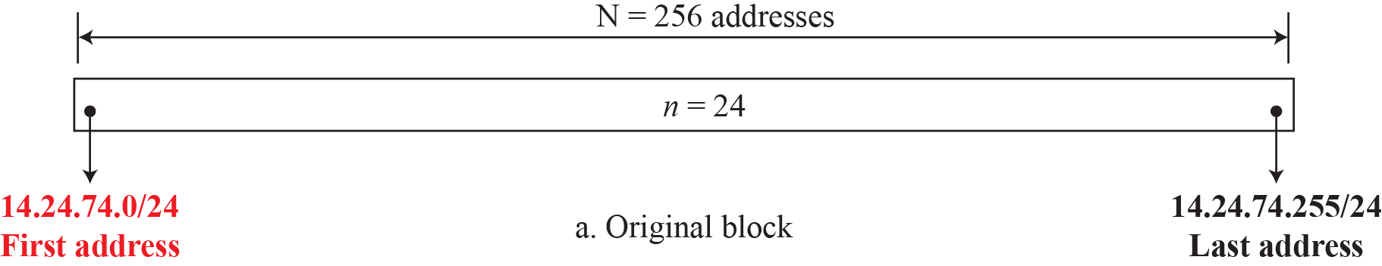
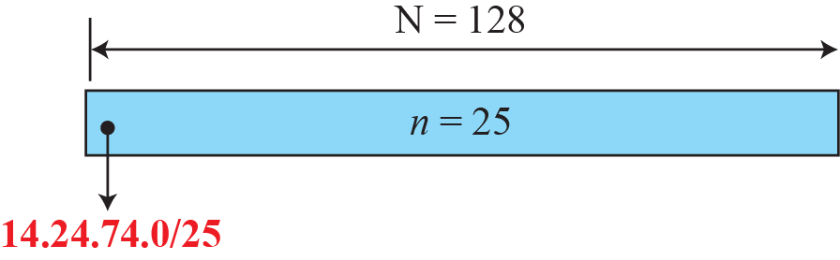
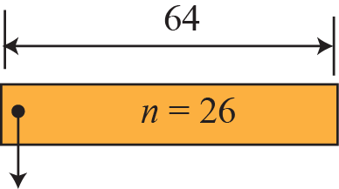
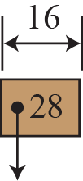
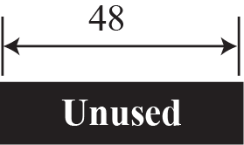
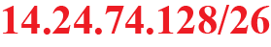
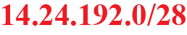
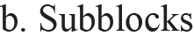
Solution
14.24.74.192/28

Slide 37
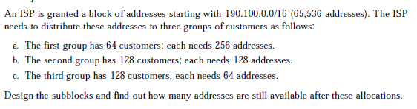

Slide 38
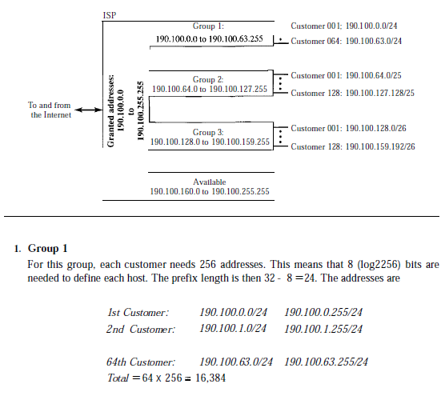

Slide 39
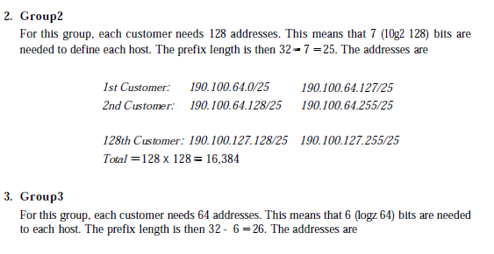

Slide 40
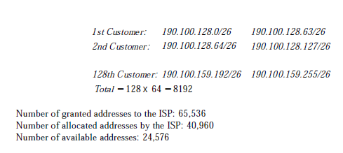

Slide 41
Classless Addressing
Address aggregation
One of the advantages of the CIDR strategy is address aggregation (sometimes called address summarization or route summarization).
When blocks of addresses are combined to create a larger block, routing can be done based on the prefix of the larger block.

Slide 42
Example
Figure 18.24 shows how four small blocks of addresses are assigned to four organizations by an ISP. The ISP combines these four blocks into one single block and advertises the larger block to the rest of the world. Any packet destined for this larger block should be sent to this ISP. It is the responsibility of the ISP to forward the packet to the appropriate organization. This is similar to routing we can find in a postal network. All packages coming from outside a country are sent first to the capital and then distributed to the corresponding destination.

Slide 43
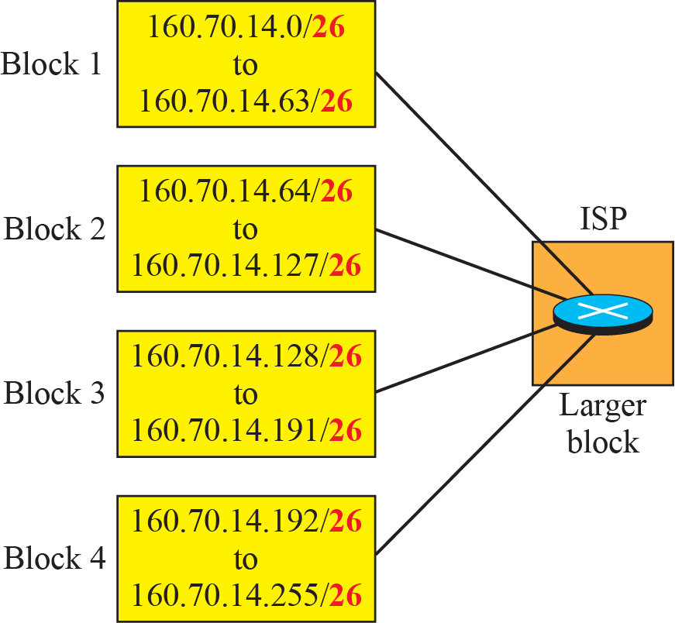
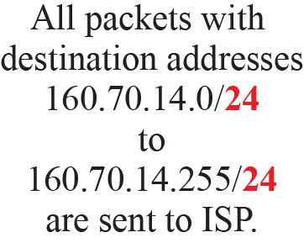
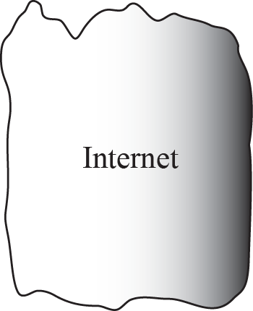
Example of address aggregation

Slide 44
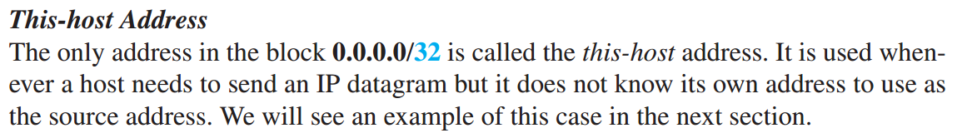
Classless Addressing
Special Addresses
Before finishing the topic of addresses in IPv4, we need to mention five special addresses that are used for special purposes: this-host address, limited-broadcast address, loopback address, private addresses, and multicast addresses.

Slide 45
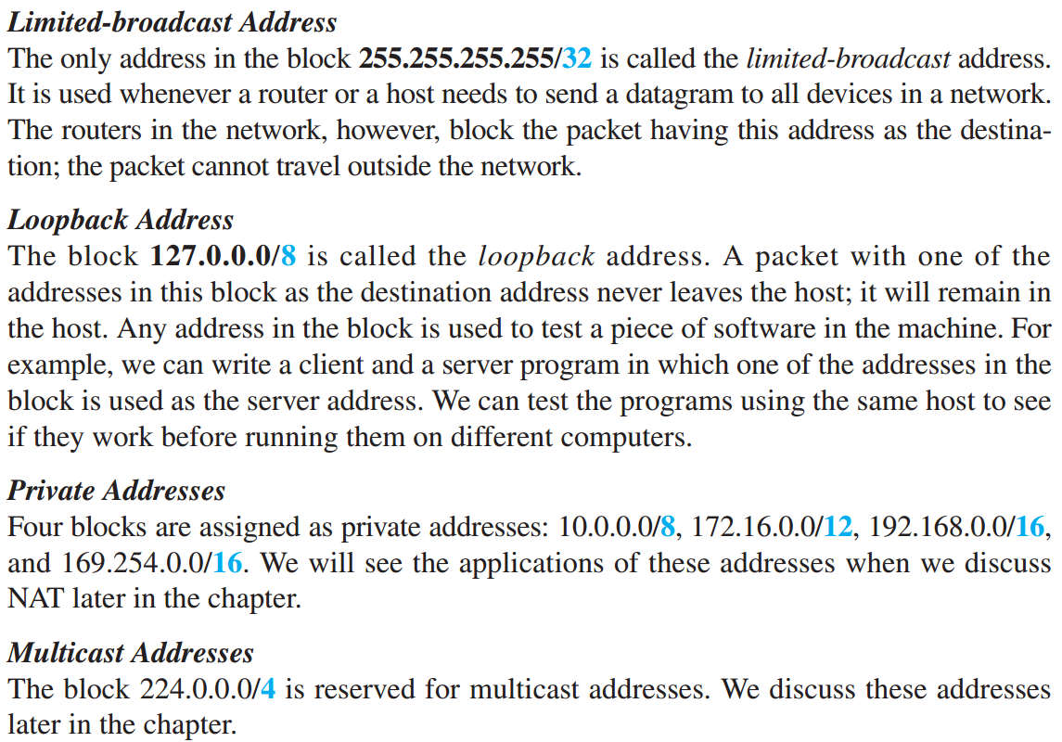
Classless Addressing
Special Addresses

Slide 46
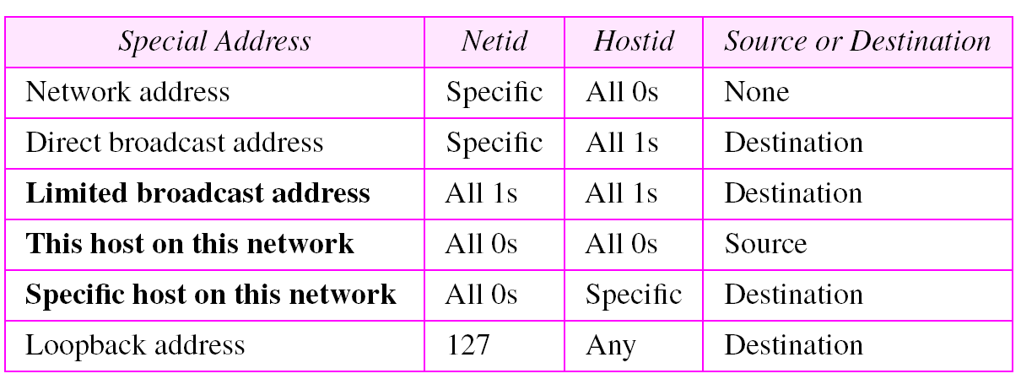

Slide 47
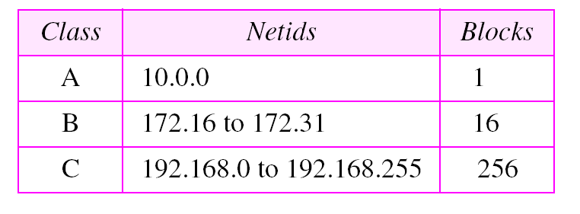
Address for private networks

Slide 48
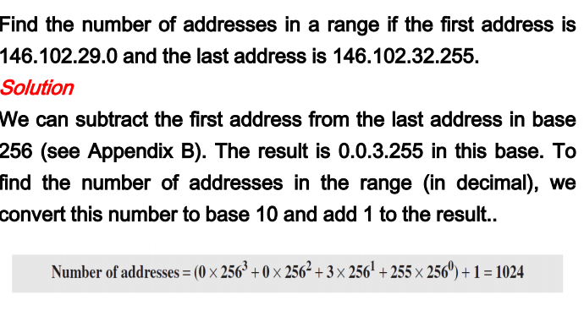
Problems

Slide 49
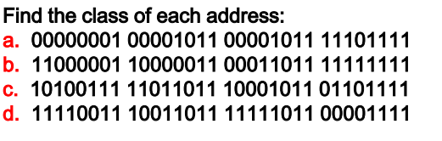

Slide 50
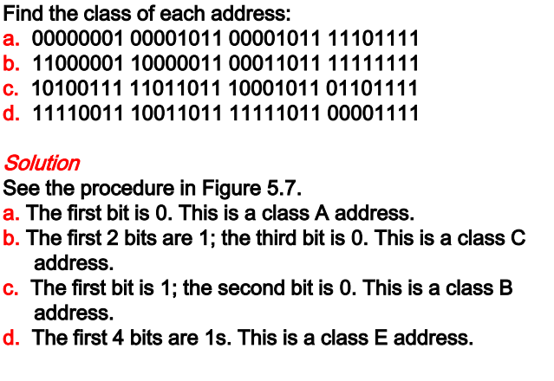

Slide 51
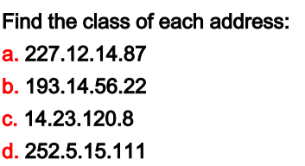

Slide 52
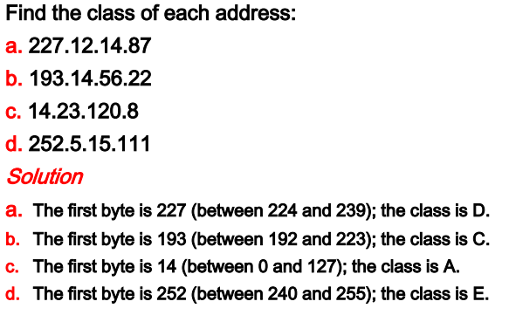

Slide 53
Check Your Understanding

Slide 54
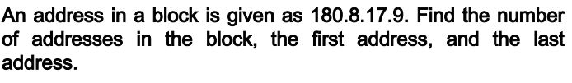

Slide 55
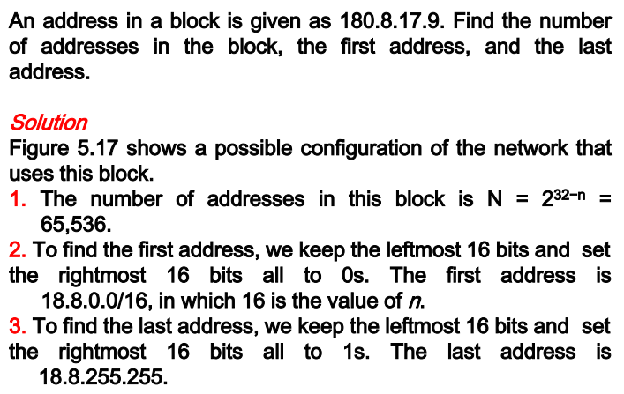

Slide 56
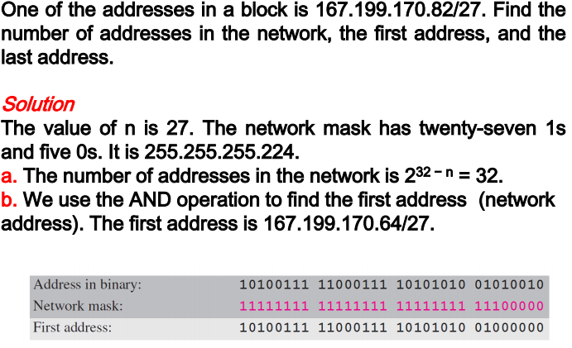

Slide 57
Outcome
Student should be able to explain
IPV4 addressing
Classless Addressing
Classful addressing
Subnetting
Special Addresses

Slide 58
THANK YOU

